Slide 1
Filtering and Edge Detection
Szymon Rusinkiewicz

Slide 2
Convolution: how to derive discrete 2D convolution
1-dimensional
2-dimensional
Discrete
Where f(i,j) is any given image, g(i,j) is a mask,
h(i,j) is an new image obtained.

Slide 3
Formalizing Edge Detection
We want to look for strong step edges
PROBLEM: We want to have edges one pixel wide:
  Solution: look for maxima in dI / dx
  It would be difficult to get with small kernel like Roberts.
PROBLEM: Noise rejection:
  Solution: smooth (with a Gaussian) over a neighborhood σ
So we want to find edges as derivatives on smoothed image

Slide 4
Canny Edge Detector
Canny Operator executes four stages in sequence:
1. Smooth with 2D Gaussian
2. Find derivative
3. Find maxima
4. Threshold

Slide 5
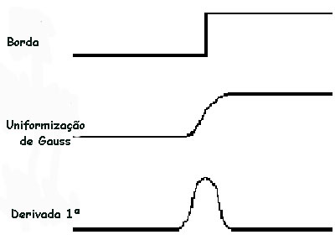
1 Step: Canny Edge Detector: smoothing
First, smooth with a Gaussian of
some width σ

Slide 6
2 Step: Canny Edge Detector: derivative
Next, find “derivative”
What is derivative in 2D? Gradient:
Derivative in 2D is a gradient vector of derivatives to x and to y

Slide 7
1st step Canny Edge Detector: Gaussian
Useful fact #1: differentiation “commutes” with convolution
Useful fact #2: Gaussian is separable
Our goal is to combine the first two stages of the Canny operator

Slide 8
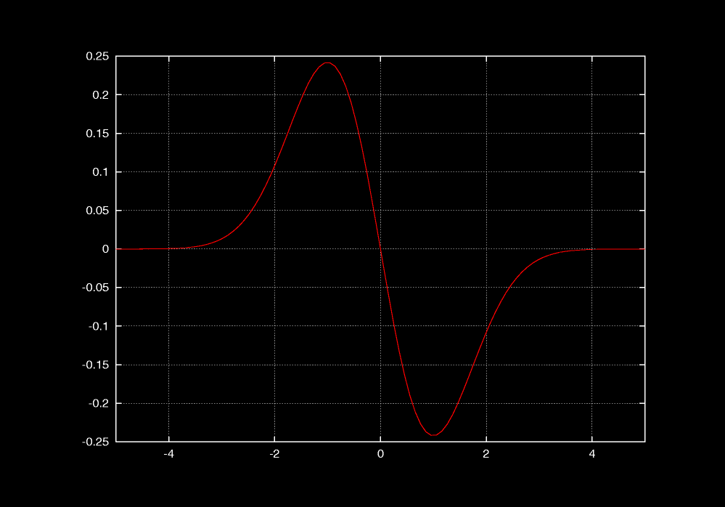
Canny Edge Detector: Combined two first stages of Canny
Thus, combine first two stages of Canny:

Slide 9
Step 3: Canny Edge Detector: calculate Maxima
Non-maximum suppression
  Eliminate all but local maxima in magnitude
  of gradient
  At each pixel look along direction of gradient:
  if either neighbor is bigger, set to zero
  In practice, quantize direction to horizontal, vertical, and two diagonals
  Result: “thinned edge image”

Slide 10
Step 4: Canny Edge Detector:
Thresholding
Final stage: thresholding
Simplest: use a single threshold
Better: use two thresholds
  Find chains of edge pixels, all greater than τ _{low}
  Each chain must contain at least one pixel greater than τ _{high}
  Helps eliminate dropouts in chains, without being too susceptible to noise
  “Thresholding with hysteresis”

Slide 11
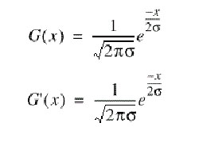
Complete Example : Canny Edge Detection
Derivative of gaussian is gaussian
Example of Canny on ideal edge model
Original image
edge
After smoothing with Gaussian (first stage)
Gauss uniformized
maximum
After derivative
1. Smooth
2. Find derivative
3. Find maxima
4. Threshold
First derivative

Slide 12
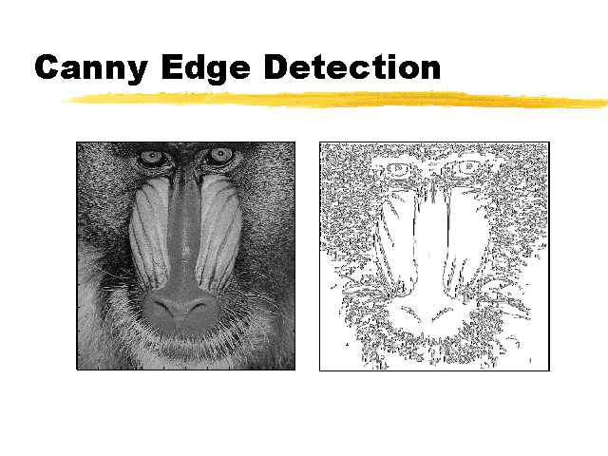
Examples of operation of Canny Edge Detection Operator
This is a very high quality operator for edge detection

Slide 13
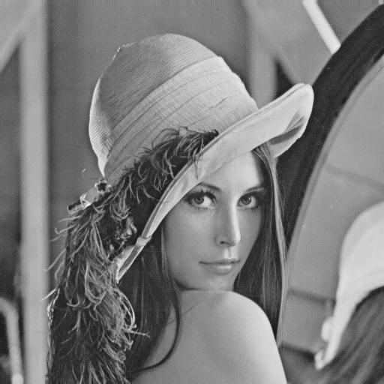
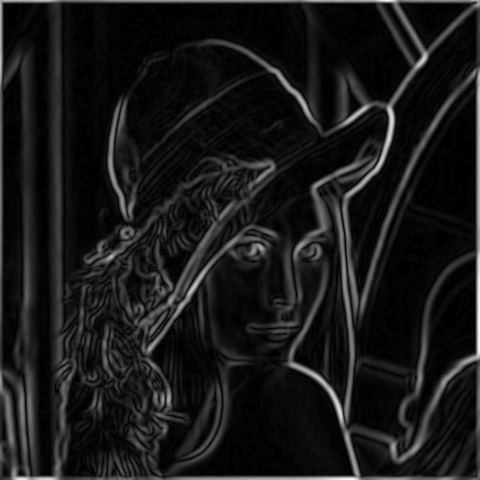
Canny Edge Detector: Smoothed Gradient
Original: Lena
Smoothed Gradient Magnitude

Slide 14
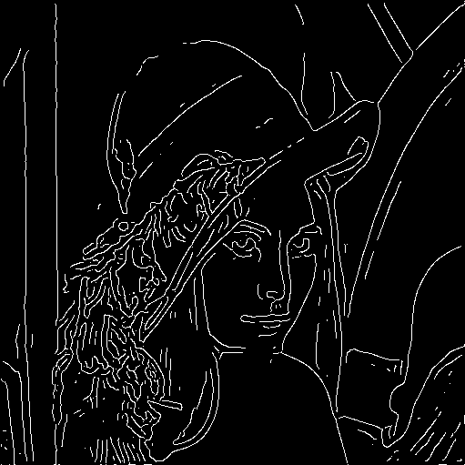
Canny Edge Detector: Final result
Original: Lena
Edges

Slide 15
Some details of derivation of Canny Masks

Slide 16
How to create masks for Gaussian Filter example?
Gaussian Filter
This explains how the kernel’s mask is created
1
1
1
[i,j]
-1
0
1
-1
0.606
0.779
0.606
(0.779-->1.3-->)1
(1.65→)2
1
0
0.779
1
0.779
(0.606→)1
1
1
1
0.606
0.779
0.606
Mask size= 3
Discrete Gaussian Filter
1
1
1
1
2
1
1
1
1
Based on Pascal’s triangle we can create
now larger masks

Slide 17
How to create masks for Gaussian Filter example?
0 1 1 0
0 1 2 1 0
Pascal Triangle
0 1 3 3 1 0
0 1 4 6 4 1 0
Take the lower integer ⎣ 3⎦ = 2
Discrete Gaussian Filter
1
1
2
1
1
1
2
2
2
1
Based on Pascal’s triangle like
approximation
2
2
4
2
2
1
2
2
2
1
1
1
2
1
1

Slide 18
Canny Edge Detector:
Derivative of Gaussian
First derivative of a Gaussian
Nonmaxima suppression (ridge thinning)
Double thresholding to detect and link edges
Gaussian filtering
S[i,j] = G[i,j; σ] ∗ I[i,j]
P[i,j] = - S[i,j] + S[i,j+1]
- S[i+1,j] + S[i+1,j+1]
Q[i,j] = S[i,j] + S[i,j+1]
- S[i+1,j] - S[i+1,j+1]
-1 1
-1 1
First derivative
1 1
-1 -1

Slide 19
Canny Edge Detector: Gaussian plus Edge direction
Step 1: Gaussian Filter
Step 2: Edge Detector
Edge Modulus
Edge Direction
In every point we can calculate modulus and angle

Slide 20
Other Edge Detectors

Slide 21
Other Edge Detectors
Can build simpler, faster edge detector by omitting some steps:
  No non-maximum suppression
  No hysteresis in thresholding
  Simpler filter

Slide 22
Second-Derivative-Based
Edge Detectors
To find local maxima in derivative, look for zeros in second derivative
Analogue in 2D: Laplacian

Slide 23
LOG or Mexican Hat Operator
Laplacian of Gaussian (LoG)
  Smoothing with a Gaussian filter
  Enhancement by second derivative edge detection
  Detection of zero crossings in second derivative in combination with large peak in first derivative
  Localization with sub-pixel resolution using linear interpolation

Slide 24
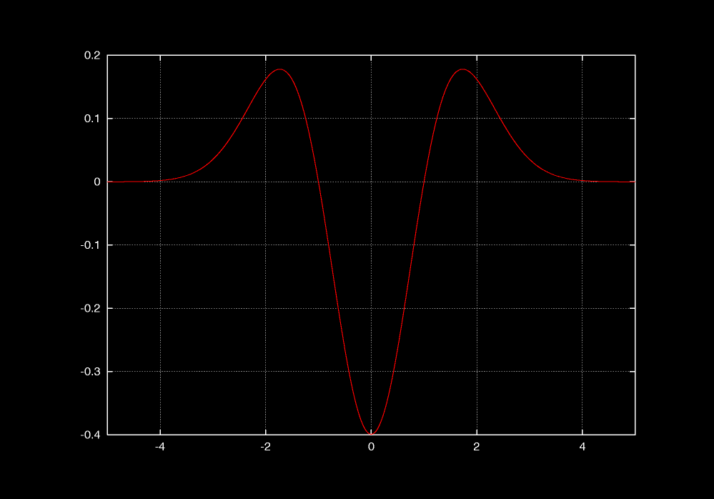
LOG = Laplacian of Gaussian
As before, combine Laplacian with Gaussian smoothing: Laplacian of Gaussian (LOG)

Slide 25
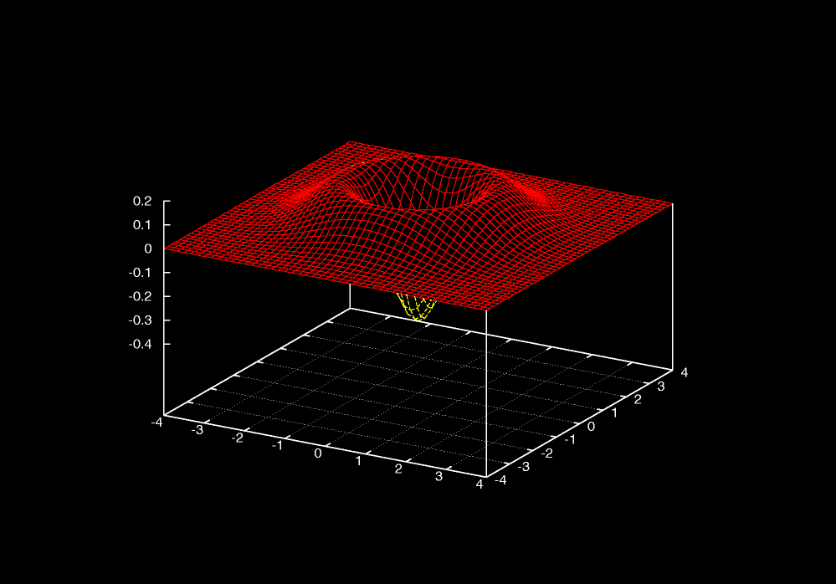
LOG
As before, combine Laplacian with Gaussian smoothing: Laplacian of Gaussian (LOG)

Slide 26
LoG-Operator
h(x,y) = Δ²[g(x,y) * f(x,y)]
= [Δ²g(x,y)] * f(x,y)
0 0 -1 0 0
0 -1 -2 -1 0
-1 -2 16 -2 -1
0 -1 -2 -1 0
0 0 -1 0 0
0 0 0 0 0 0 -1 -1 -1 -1 -1 0 0 0 0 0 0
0 0 0 0 -1 -1 -1 -1 -1 -1 -1 -1 -1 0 0 0 0
0 0 -1 -1 -1 -2 -3 -3 -3 -3 -3 -2 -1 -1 -1 0 0
0 0 -1 -1 -2 -3 -3 -3 -3 -3 -3 -3 -2 -1 -1 0 0
0 -1 -1 -2 -3 -3 -3 -2 -3 -2 -3 -3 -3 -2 -1 -1 0
0 -1 -2 -3 -3 -3 0 2 4 2 0 -3 -3 -3 -2 -1 0
-1 -1 -3 -3 -3 0 4 10 12 10 4 0 -3 -3 -3 -1 -1
-1 -1 -3 -3 -2 2 10 18 21 18 10 2 -2 -3 -3 -1 -1
-1 -1 -3 -3 -3 4 12 21 24 21 12 4 -3 -3 -3 -1 -1
-1 -1 -3 -3 -2 2 10 18 21 18 10 2 -2 -3 -3 -1 -1
-1 -1 -3 -3 -3 0 4 10 12 10 4 0 -3 -3 -3 -1 -1
0 -1 -2 -3 -3 -3 0 2 4 2 0 -3 -3 -3 -2 -1 0
0 -1 -1 -2 -3 -3 -3 -2 -3 -2 -3 -3 -3 -2 -1 -1 0
0 0 -1 -1 -2 -3 -3 -3 -3 -3 -3 -3 -2 -1 -1 0 0
0 0 -1 -1 -1 -2 -3 -3 -3 -3 -3 -2 -1 -1 -1 0 0
0 0 0 0 -1 -1 -1 -1 -1 -1 -1 -1 -1 0 0 0 0
0 0 0 0 0 0 -1 -1 -1 -1 -1 0 0 0 0 0 0

Slide 27
Edge Detection: Laplacian
Second Order Kernels
  non-directional
  results in closed curves (contours)
  example: Laplacian
sum=0
4-4=0 8-8=0
Replace output pixel values with sign changes (zero crossings)
0 -1 0
-1 4 -1
0 -1 0
-1 -1 -1
-1 8 -1
-1 -1 -1

Slide 28
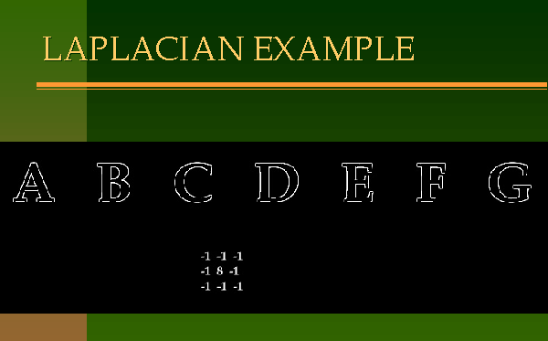
Edge Detection using Laplacian

Slide 29
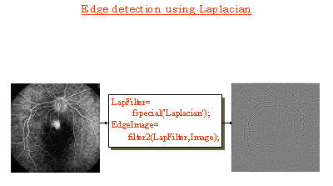
Edge Detection using Laplacian
Select a mask
Image
EdgeImage

Slide 30
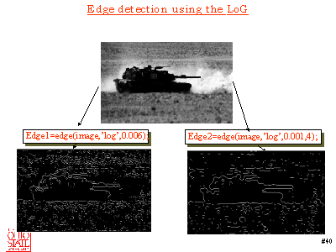
Edge Detection using the LoG

Slide 31
Problems with
Laplacian Edge Detectors
How to use Local minimum vs. local maximum information
The operator is Symmetric – it gives poor performance near corners of image
Sensitive to noise along an edge
  Higher-order derivatives = greater noise sensitivity

Slide 32

Marr-Hildreth Operator
Like Laplacian but no sum of second derivatives

Slide 33
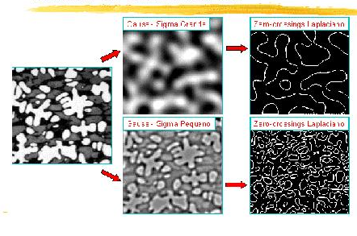
Marr-Hildreth Algorithm
Marr-Hildreth Operator

Slide 34
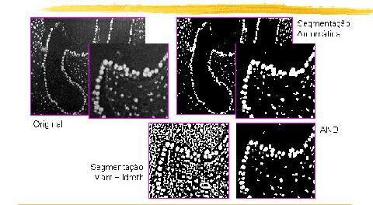
Marr-Hildreth Operator
Marr-Hildreth Algorithm

